Slide 1
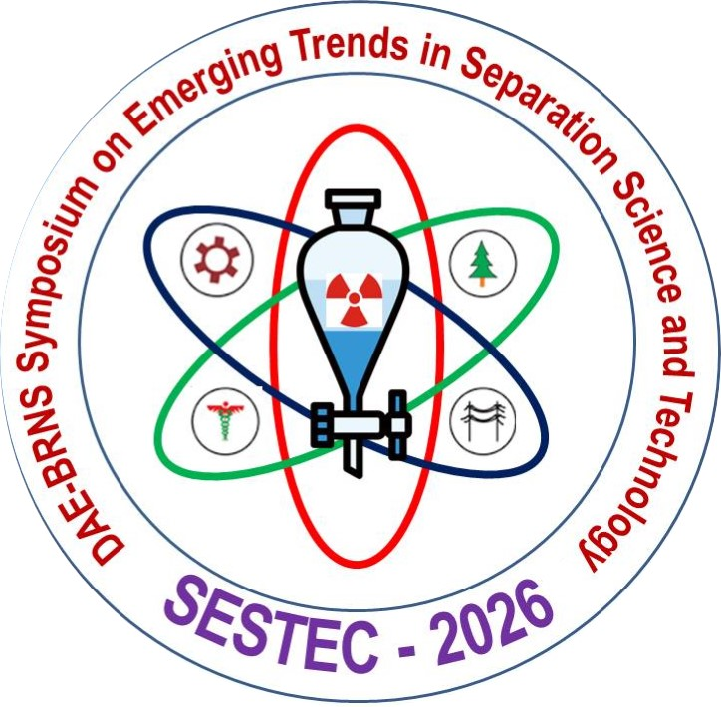
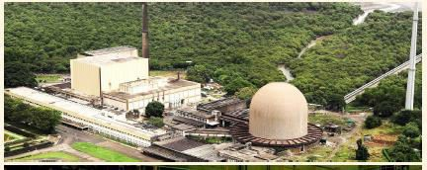
Title should be in Times New Roman, Bold, with a font size of 66
Author1*, Author2,Times New Roman Bold 48
Affiliation1, Affiliation2 Times New Roman 48
*Corresponding author: xbcdef@ghij.klm.in (times new roman 44)
Paper No: A-01
Poster should be of 85 cm X 85 cm in size
Abstract/ Introduction/ Motivation
Times New Roman Font size 44
There is a need as well as scope to enhance the utilization of neutrons from research reactors by various R&D communities and users from various organizations for materials characterization, nuclear reaction & fission, health care and various societal applications.
Experimental: Times New Roman Bold Font Size 50
Results and Discussion:
Table 1: Comparison of the analysis results using the two sets of standards
Sr No | Elements | Method A (with 35% standards) | Method B (with 50% standards)
1 | Al | 15 | 12
2 | B | 0.15 | 0.18
3 | Be | 0.12 | 0.15
4 | Ca | 10 | 10
5 | Cd | 0.10 | 0.15
6 | Co | 14 | 10
7 | Cr | 22 | 20
8 | Cu | 5 | 8
9 | Fe | 25 | 30
10 | Mg | 17 | 13
11 | Mn | 8 | 10
12 | Mo | 11 | 8
13 | Na | 4 | 6
ASSET logo
Fig. 1 Photograph of Research Reactors at BARC
Methodology of Analysis: Times New Roman Bold Font Size 50
The Theme Meeting is intended for scientists, engineers, academicians, doctors and research scholars from DAE and non-DAE organization including Academic Institutes / Universities, Hospitals and Industries working in the fields like reactor physics & technology, radioisotope production & applications, neutron scattering, neutron imaging, detector testing, neutron activation analysis & nuclear reactions and fission.
References:
G. Author, H. Coauthor, J. Radioanal. Nucl. Chem., 250 (2019) 1.
A. Author et al., BARC Report , Issue No. (
Year) p-p. (For Reports & Book Chapters)
Conclusion
The main objective of this Theme Meeting is aimed at interaction with the potential users of research reactors at BARC, other units of DAE as well as non-DAE government and private organizations
including industries, research and academic institutes and Institutes/Universities that are pursuing projects under BRNS, and UGC-DAE CSR

